Slide 1
Steady-State Analysis

Slide 2

Introduction
Steady-State Error for Unity Feedback System
Static Error Constants and System Type
Steady-State Error for Non-Unity Feedback Systems

Slide 3

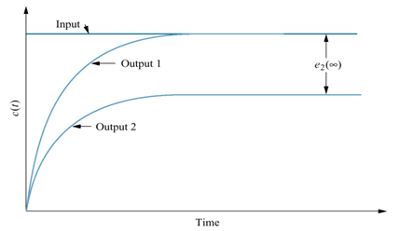
Steady-state error, e_{ss}: The difference between the input and the output for a prescribed test input as time, t approaches ∞.
Step Input

Slide 4
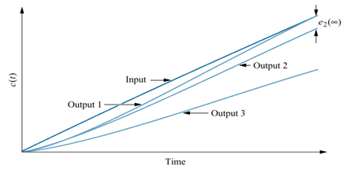
Steady-state error, e_{ss}: The difference between the input and the output for a prescribed test input as time, t approaches ∞.
Ramp Input

Slide 5

Test Inputs: Used for steady-state error analysis and design.
Step Input:
  Represent a constant position.
  Useful in determining the ability of the control system to position itself with respect to a stationary target.
Ramp Input:
  Represent constant velocity input to a position control system by their linearly increasing amplitude.
Parabolic Input:
  Represent constant acceleration inputs to position control.
  Used to represent accelerating targets.

Slide 6
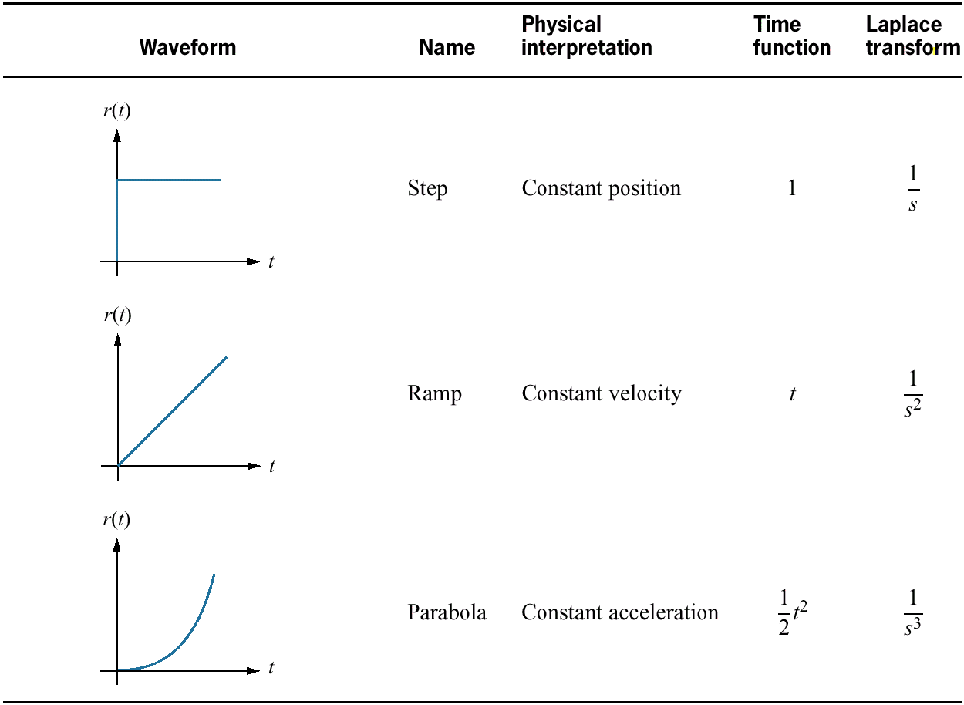

Slide 7

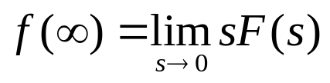
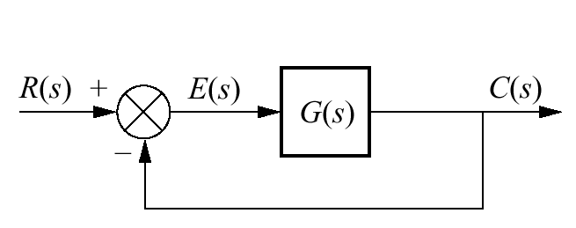


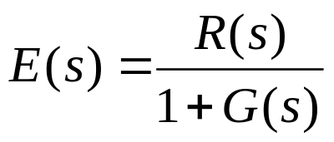
To determine the steady-state error, we apply the Final Value Theorem:
The following system has an open-loop gain, G(s) and a unity feedback since H(s) is 1. Thus to find E(s),
Substituting the (2) into (1) yields,
(1)
(2)

Slide 8
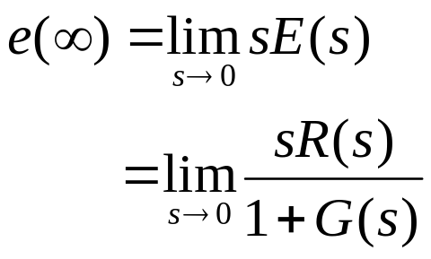
By applying the Final Value Theorem, we have:
This allows the steady-state error to be determined for a given test input, R(s) and the transfer function, G(s) of the system.

Slide 9
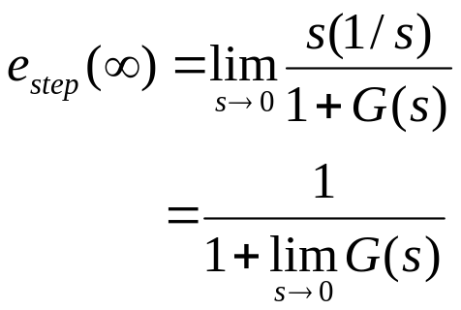


For a unit step input:
The term:
  The dc gain of the forward transfer function, as the frequency variable, s approaches zero.
To have zero steady-state error,

Slide 10
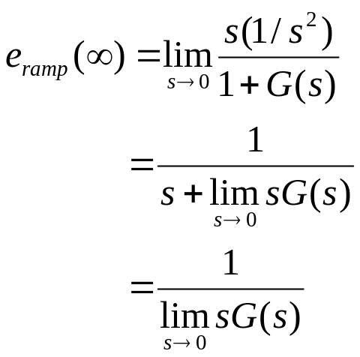


For a unit ramp input:
To have zero steady-state error,
If there are no integration in the forward path:
Then, the steady state error will be infinite.

Slide 11
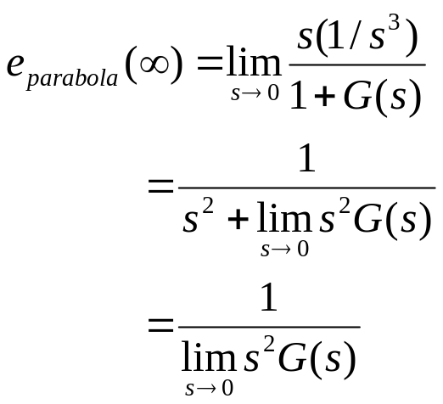
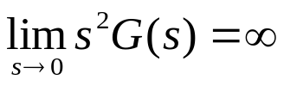

For a unit parabolic input:
To have zero steady-state error,
If there are one or no integration in the forward path:
Then, the steady state error will be infinite.

Slide 12
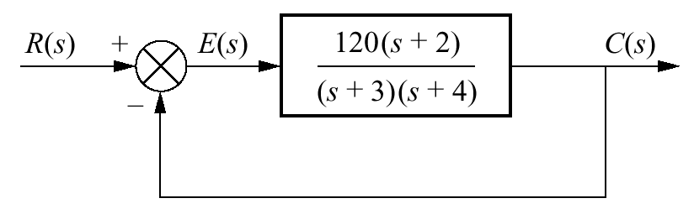
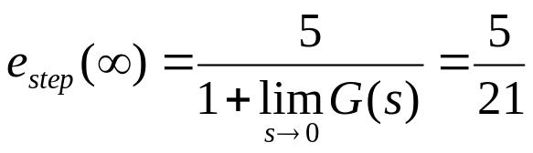
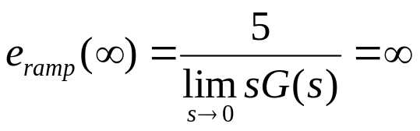
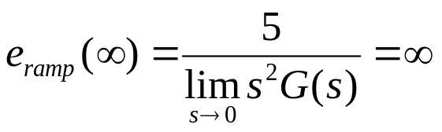
Example: Find the steady-state errors for inputs of 5u(t), 5tu(t), and 5t²u(t).

Slide 13

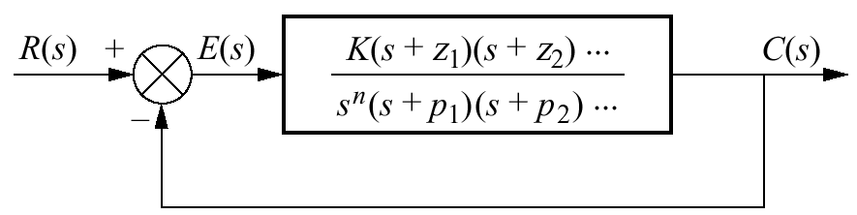
System Type: The value of n in the denominator or, the number of pure integrations in the forward path.
Therefore,
  If n = 0, system is Type 0
  If n = 1, system is Type 1
  If n = 2, system is Type 2

Slide 14
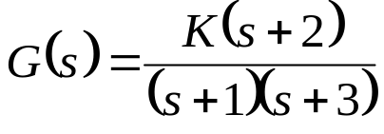
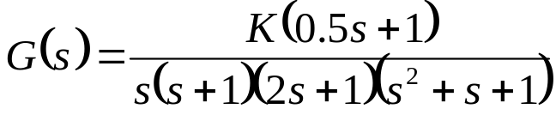
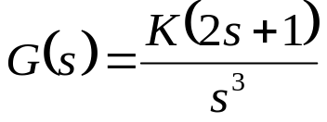
Example:
Problem: Determine the system type.
Type 0
Type 1
Type 3

Slide 15



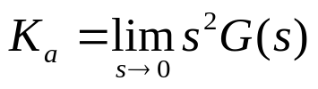
Static Error Constants: Limits that determine the steady-state errors.
Position constant:
Velocity constant:
Acceleration constant:

Slide 16

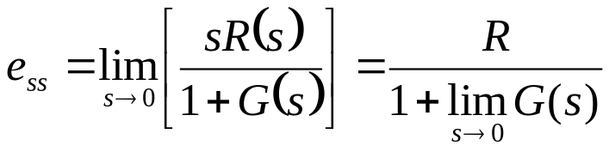


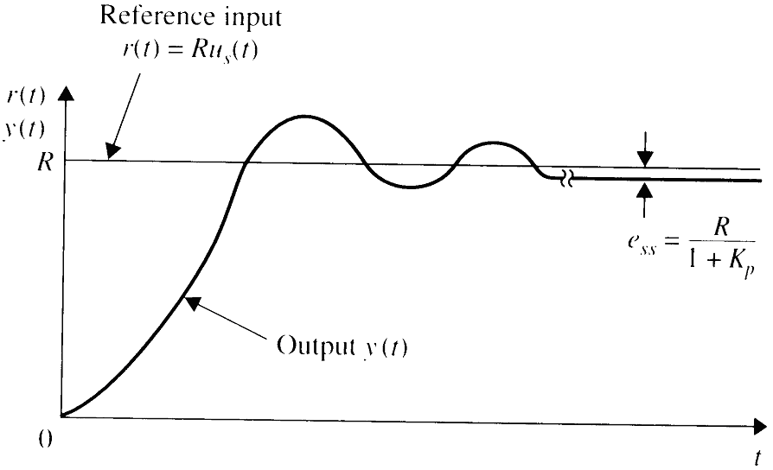
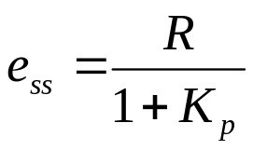
Steady-state error for step function input, R(s):
Position error constant:
Thus,

Slide 17

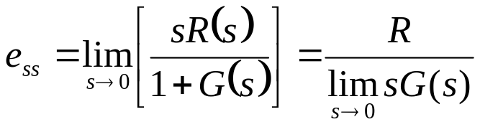


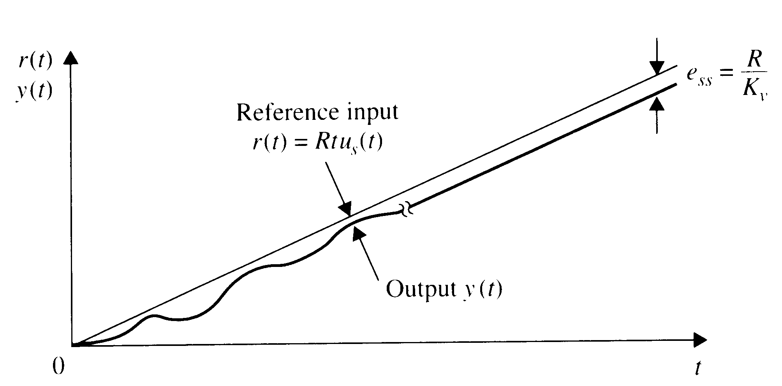
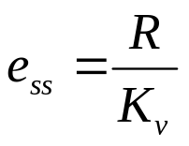
Steady-state error for step function input, R(s):
Position error constant:
Thus,

Slide 18

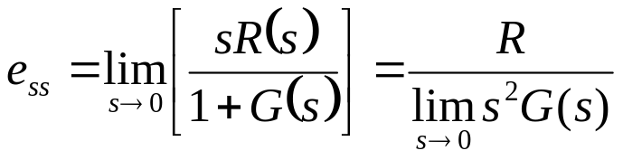


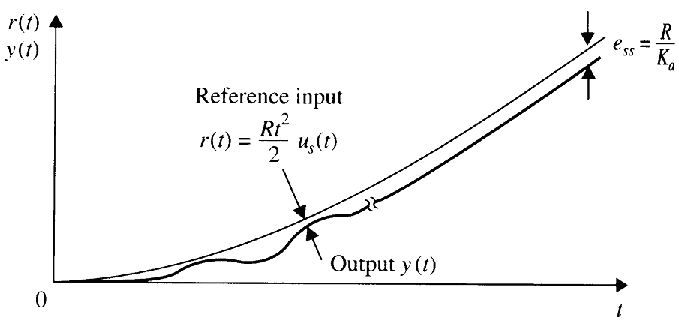
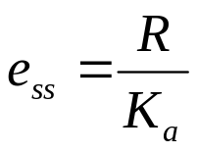
Steady-state error for step function input, R(s):
Position error constant:
Thus,

Slide 19

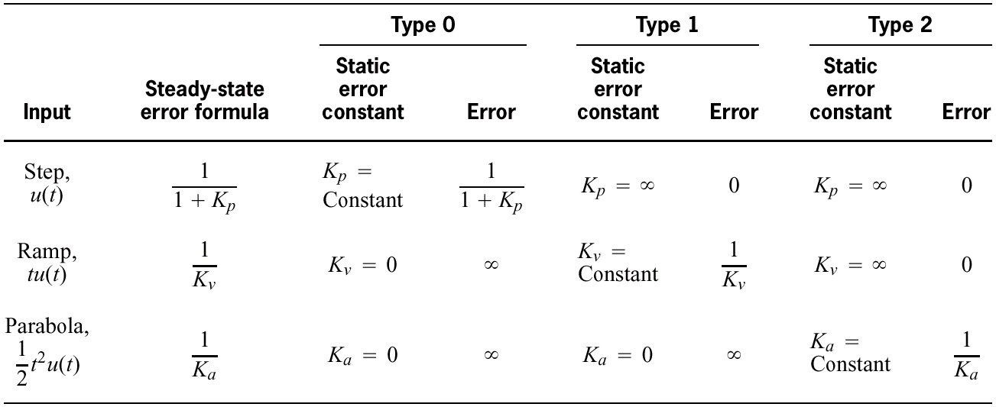
Relationships between input, system type, static error constants, and steady-state errors:

Slide 20


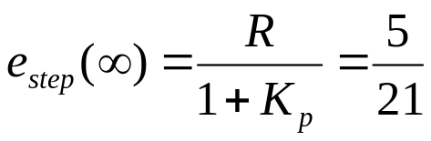
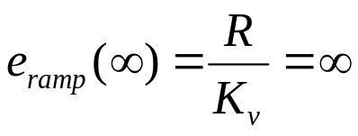
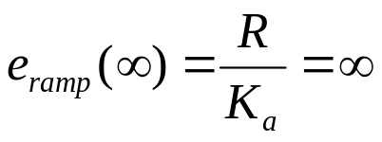
Example: Find the steady-state errors for inputs of 5u(t), 5tu(t), and 5t²u(t) by first evaluating the static error constants.

Slide 21

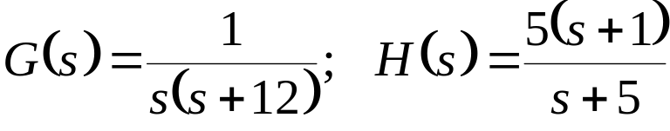
Example: Calculate the error constants and determine e_{ss} for a unit step, ramp and parabolic functions response of the following system.

Slide 22
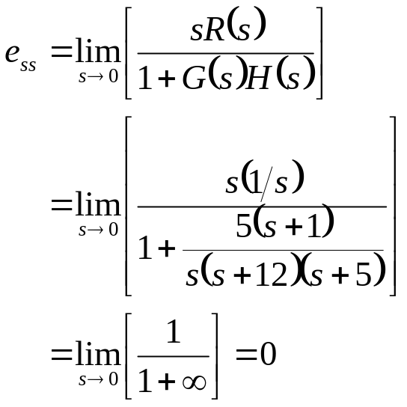
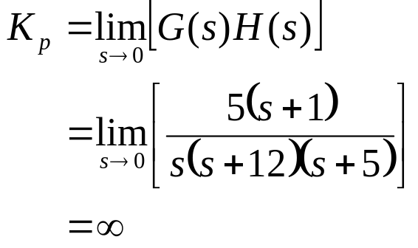
Example: Calculate the error constants and determine e_{ss} for a unit step, ramp and parabolic functions response of the following system.
For step input,

Slide 23
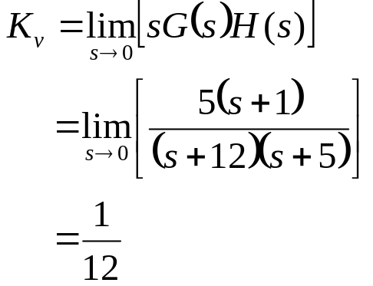
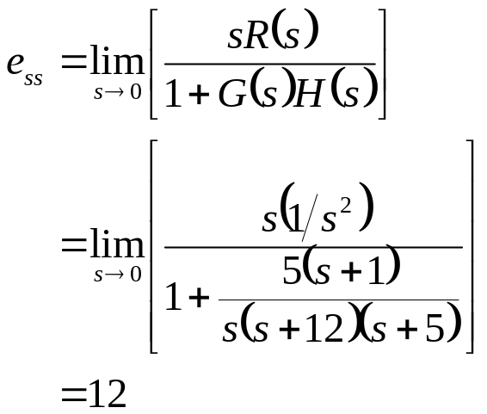
Example: Calculate the error constants and determine e_{ss} for a unit step, ramp and parabolic functions response of the following system.
For ramp input,

Slide 24
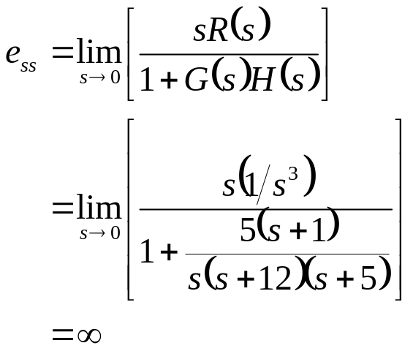
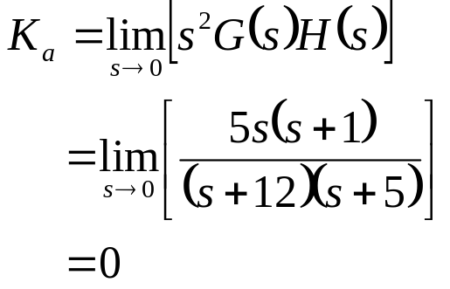
Example: Calculate the error constants and determine e_{ss} for a unit step, ramp and parabolic functions response of the following system.
For parabolic input,

Slide 25
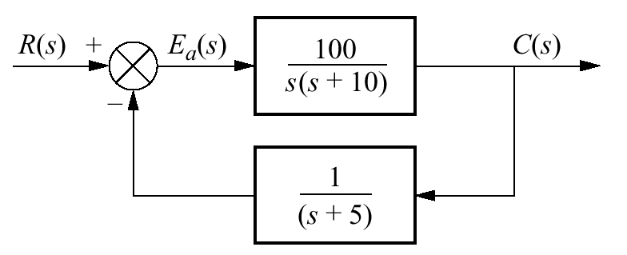
Problem: Calculate the error constants and determine e_{ss} for a unit step, ramp and parabolic functions response of the following system.

Slide 26


"A scientist can discover a new star, but he cannot make one. He would have to ask an engineer to do that…"

